Slide 1
Reiri DB Backup Tool
Handover Document

Slide 2
Introduction
The Reiri DB Backup Tool is a Windows desktop application that continuously backs up operational data from Reiri HVAC controllers to a local PC database.
Purpose:
Protect critical time-series data (history, meter, optime, trend, PPD) against data loss on the controller by maintaining an up-to-date local copy.
How it works(high level):
The app runs 24/7 on a Windows PC in the background.
It connects to Reiri controller over the network (LAN or cloud).
It copies new database records from the controller to local SQLite files on the PC.
The backed-up files are directly restorable via the Reiri Setup Tool.
Target platform: Windows 10/11, built with flutter

Slide 3
System Overview
The system has three main components:
Reiri Controller — the source of data
Stores operational data in 5 SQLite databases: history, meter, optime, trend, ppd.
Reiri DB Backup Tool — this application
Runs continuously on a Windows PC.
Connects to the controller via WebSocket (LAN or cloud).
Pulls and/or receives data, writes it to a local copy of the databases.
Local PC Storage — the backup destination
Stores local copies of all database files in a user-configured folder.
Maintains metadata (last backup timestamps, state) in a JSON file.
Controller
Request data
Send data
Reiri DB Backup Tool
Send data for backup
Restore data if data loss in controller
Local PC Storage

Slide 4
Project purpose and scope
Maintain a local backup of operational and time-series data from Reiri controllers.
Create an historical data baseline by FTP download or local import.
Continue receiving new database records in real time.
Detect data gaps caused by network loss or application closure.
Recover missing controller data and merge it into the local backup.
Additional document to refer (can be found in team folder Reiri DB Backup Tool or project root):
Reiri DB Backup Tool - System Design
Reiri DB Backup Tool - Screen Transition
Reiri DB Backup Tool - Screen Specification

Slide 5
Repositories & Dependencies
Component | Expected location | Responsibility
reiri_db_backup_tool | Main repo | UI, backup workflow, monitoring, recovery
reiri_app_core | ../reiri_app_core | Controller communication, shared app object, SQLite writes
std_widget | ../std_widget | Shared UI widgets
reiri_setup_tool |  | Downloads original controller DB for comparing
db_compare_tool | DB Compare Tool | Compare SQLite tables and records
<development-root>\
├── reiri_db_backup_tool\
├── reiri_app_core\
└── std_widget\
Login this controller for testing:
Reiri Office TouchF04-Don MSM1

Slide 6
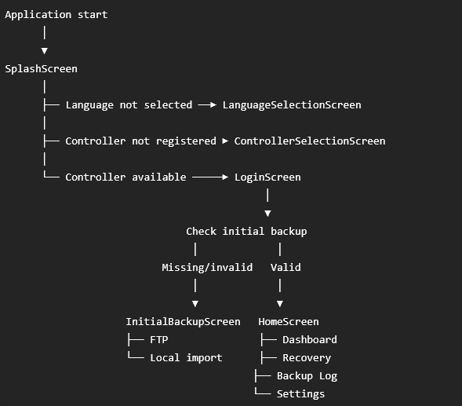
Application flow
Key behaviour
Auto-login may move directly from Splash to the backup check.
Initial backup is required if any managed database is missing or empty.
A valid initial backup allows the application to open Home directly.

Slide 7
Backup databases
Database | Data type | Expected interval | Main key
history.db | Event history | Event-based | Composite event identity
meter.db | Meter values and consumption | 15 minutes | date + id
optime.db | Operating time | 15 minutes | date + id
trend.db | Trend values | 5 minutes | date + id
ppd.db | PPD calculation data | 15 minutes | date + id

Slide 8
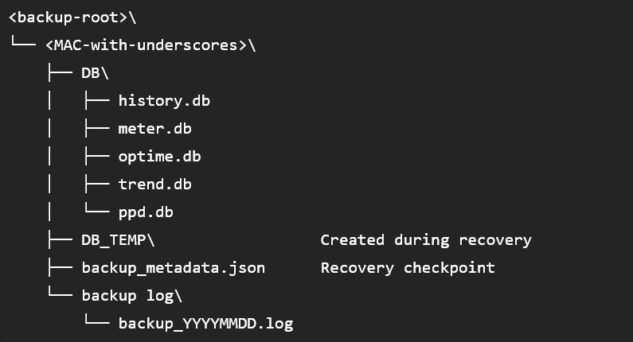
Backup Folder Structure

Slide 9
Initial Backup Method
The initial backup establishes the historical data baseline. After completion, newly received data is appended continuously in real time.
 | FTP Backup | Local Import
Data source | Download directly from controller | Import DB files from local folder
Connection | Requires cloud network and FTP access | No controller connection required
Best used when | Controller is online and reachable | Backup files are already available locally
Data flow
Choose backup method → Load historical data → Continuous real-time backup

Slide 10
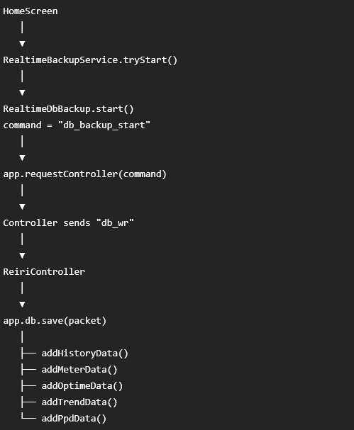
Continuous real-time backup
Start conditions
Local backup database is ready.
Controller connection state is ready.
The subscription has not already been started.
Important design point
app.setDbPath() determines whether incoming data is written to MAIN DB or recovery DB_TEMP.

Slide 11
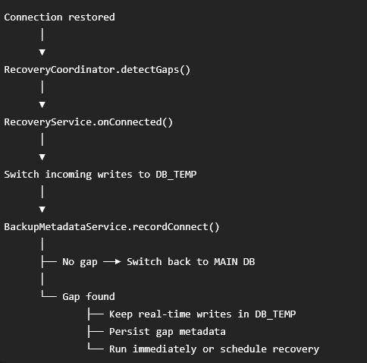
Missing data gap detection
Why TEMP is selected first
Gap calculation is asynchronous.
A new controller packet may arrive during calculation.
Staging to DB_TEMP prevents live records from entering MAIN before the correct recovery decision is known.
Gap rules
trend.db: check missed 5-minute boundaries (3:30pm, 3:35pm etc).
meter.db, optime.db, ppd.db: check missed 15-minute boundaries (3:30pm, 3:45pm etc).
Any positive disconnect window may contain missing history.db events.

Slide 12
Scenario 1
Real-time backup
(write to MAIN DB)
Real-time backup
switch writing to TEMP DB
After missing data recovered,
real-time backup switch back to MAIN DB
Scheduled recovery
4pm, 28th Jul
6pm
3am , 29th Jul
3:02am
Controller down
Controller reconnect
Pull missing data (4-6pm) from controller.
Append 4-6pm data into MAIN
Append 6pm-3am data from TEMP to MAIN

Slide 13
Scenario 2
After missing data recovered,
real-time backup switch back to MAIN DB
Real-time backup
(write to MAIN DB)
Real-time backup
switch writing to TEMP DB
Real-time backup continue
writing to TEMP DB
Scheduled recovery
10am, 28th Jul
11am
4pm
6pm
3am , 29th Jul
3:05am
Controller down
Controller reconnect
Controller down
Controller reconnect
Pull missing data (10-11am & 4-6pm) from controller.
Append 10-11am data into MAIN
Append 11am-4pm data from TEMP to MAIN
Append 4-6pm into MAIN
Append 6pm-3am data from TEMP to MAIN
* To maintain chronological records in MAIN

Slide 14
Connection monitoring and database status
Activity | Frequency | Responsibility
TCP reachability probe | 10 seconds | ConnectionMonitorService
Failure threshold | 3 consecutive failures | Avoid false disconnects
Controller port | 52001 | Local controller reachability
Heartbeat and status refresh | 1 minute | HomeScreen
Windows sleep detection | Timer delay greater than 2 minutes | Record a possible gap
Record verification | On detected file changes | DatabaseStatusService

Slide 15
Configuration
Item | Location or behavior
Backup root | Stored per controller MAC
Initial backup status | INITIAL_HISTORY_BACKUP_DONE_V1
Recovery schedule | RECOVERY_SCHEDULE_TIME_V1
Default recovery time | 03:00
Instant recovery preference | RECOVERY_MODE_INSTANT_V1
Recovery metadata | <root>\<MAC>\backup_metadata.json
Diagnostic logs | <root>\<MAC>\backup log\backup_YYYYMMDD.log
Structured logs | App settings; exportable as CSV to JSON

Slide 16
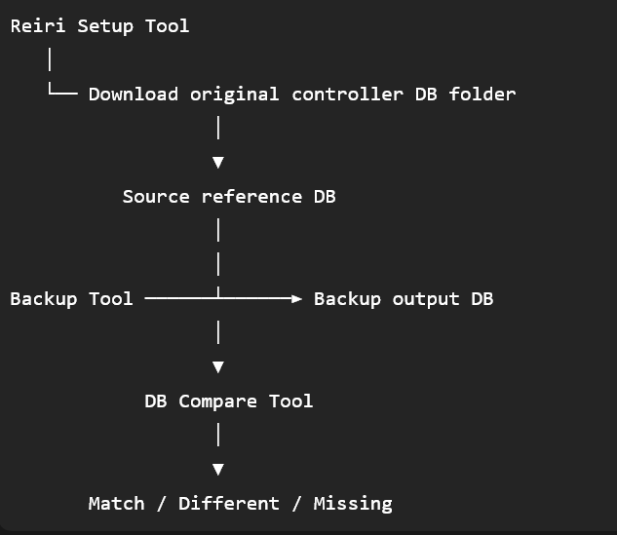
DB Validation using DB Compare tool
Download original controller from setup tool
Compare the original controller data and DB backup tool backup data side by side using DB compare tool
Team folder:
DB Compare Tool

Slide 17
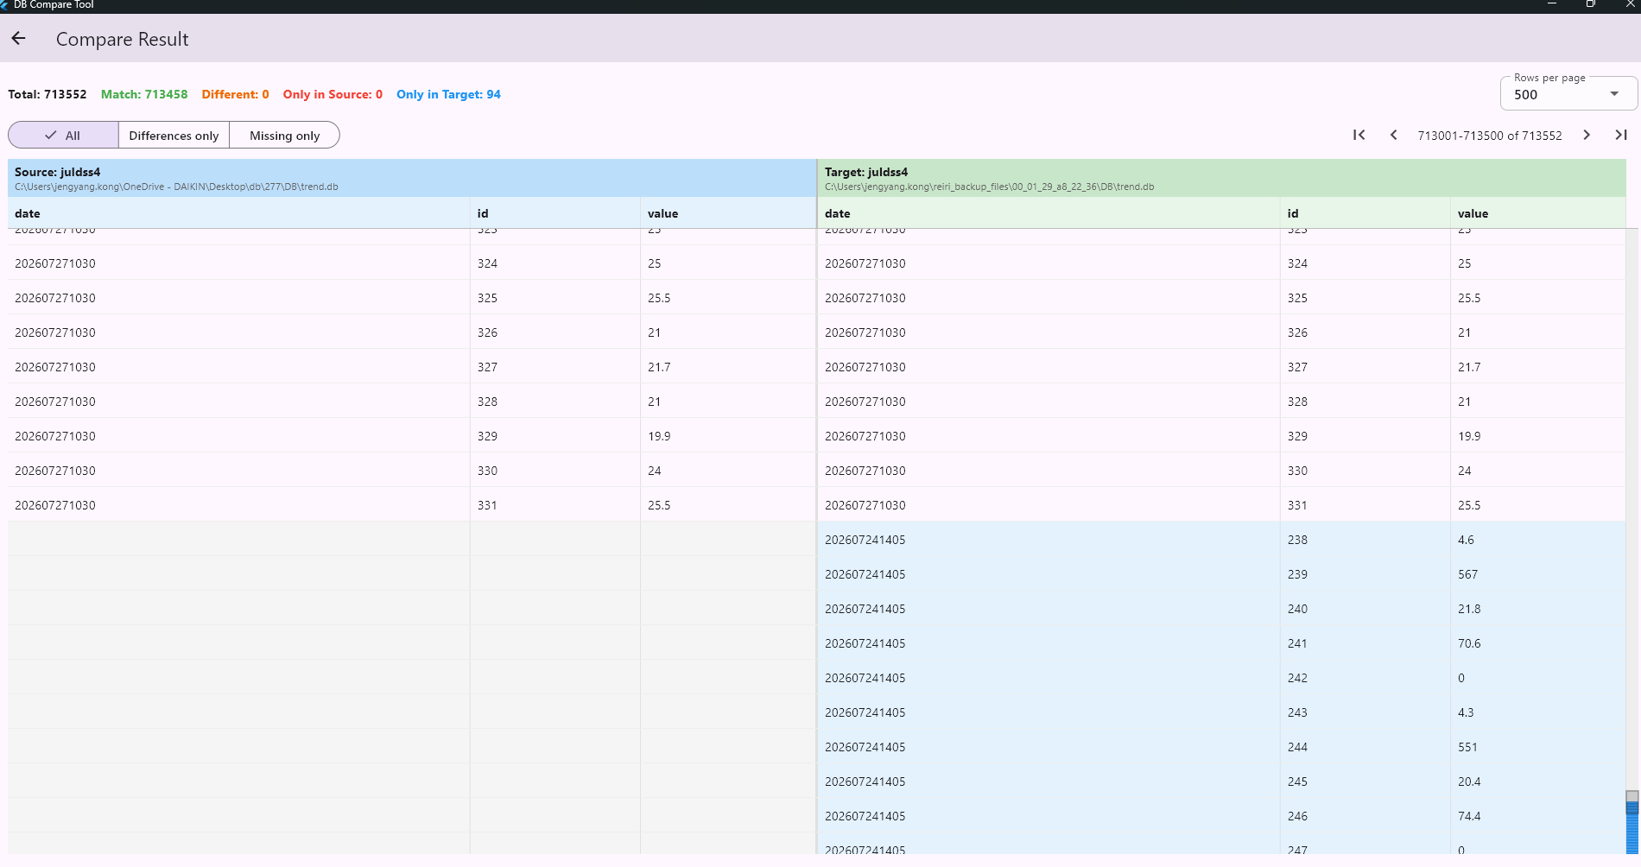
Screenshot of DB Compare Tool

